Slide 1


Virtual Labs Ver 3.0
Daniel Gonzalez
Crystal Rivera – Scrum Master
Juan Riano
Johann Henao
Trung Ngo

Slide 2
Problem Definition
Virtual Labs has been using VMware
  VMware is a proprietary solution that allows for the creation of virtual Machines
Switch from VMware to Kernel-based Virtual Machine (KVM)
  KVM is an open source solution
The virtual clusters must be made to support KVM
All previous scripts and software must be updated to support KVM

Slide 3
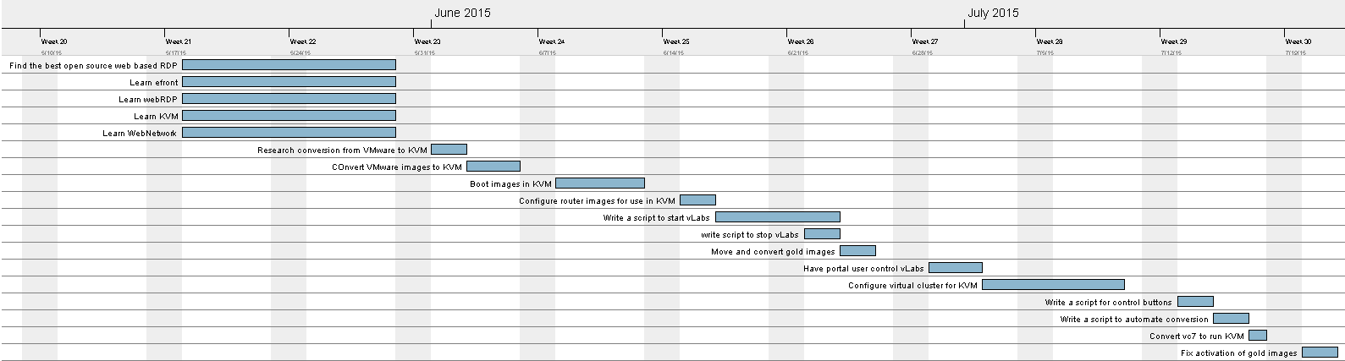
Project Management

Slide 4
Implemented Use Cases
Start vLabs
Stop vLabs
Destroy vLabs
Use control buttons
  Start VM
  Stop VM
  Reboot VM
  Suspend VM
  Refresh VM
Automate conversion

Slide 5
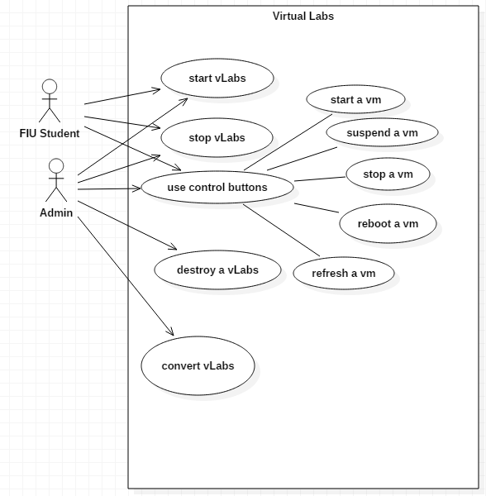
Use Case Diagram

Slide 6
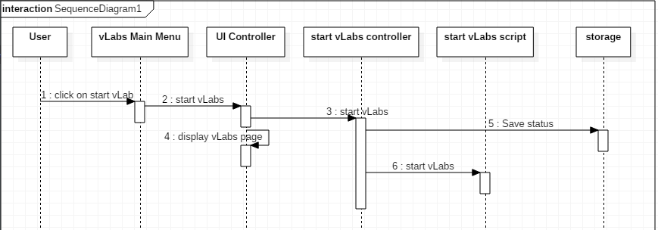
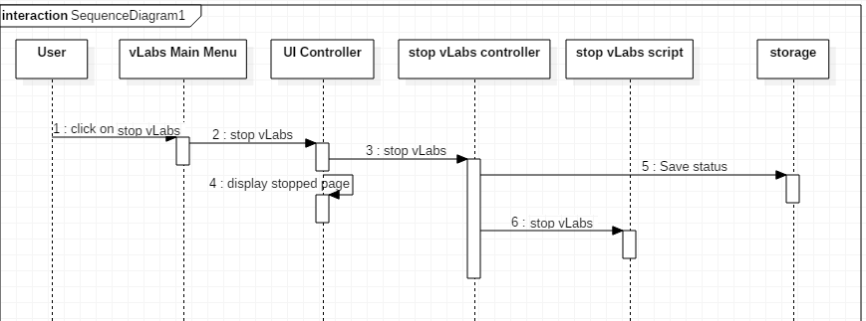
Sequence Diagrams

Slide 7
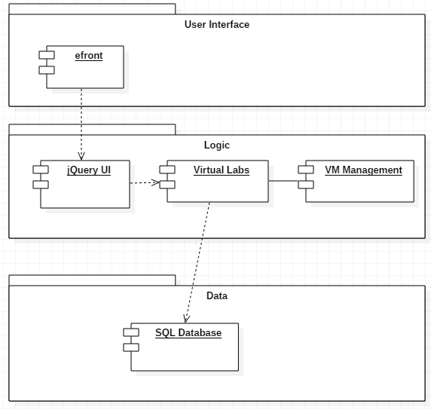
System Decomposition

Slide 8
System Deployment
Hardware Requirements
CentOS Linux Kernel
64 GB RAM
1.5 TB Storage
4 x 2.4 GHz CPU 6 Cores
Software Requirements
Python 2.6
  pxssh
Nmap
KVM
libvirt

Slide 9
Persistent Data
All persistent data for KVM is stored in flat files
Other persistent data is stored in a SQL database
  This data is only used to interact with KVM, nothing is stored, modified, or erased

Slide 10
Security
KVM's hypervisor qemu:///system only allows for the virtual machines in root
Only Portal user and root have access to KVM
Standard Linux security

Slide 11
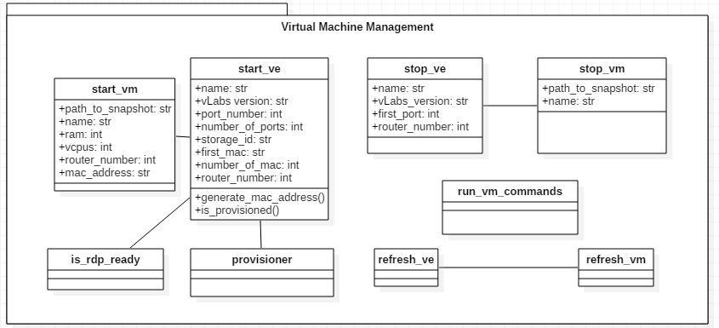
Class Diagram

Slide 12
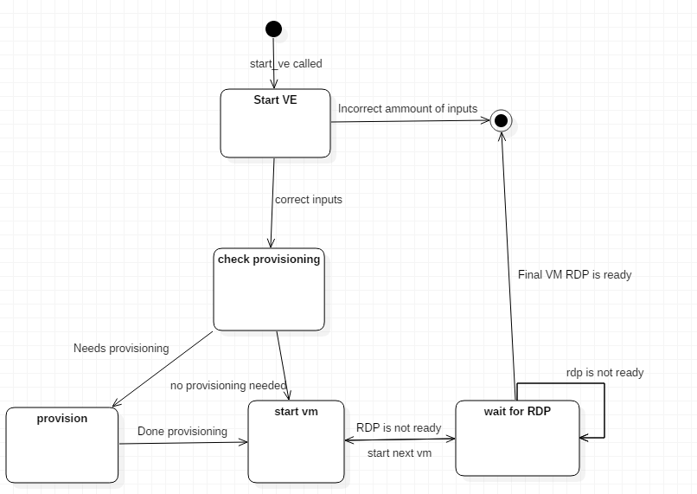
State Machine

Slide 13
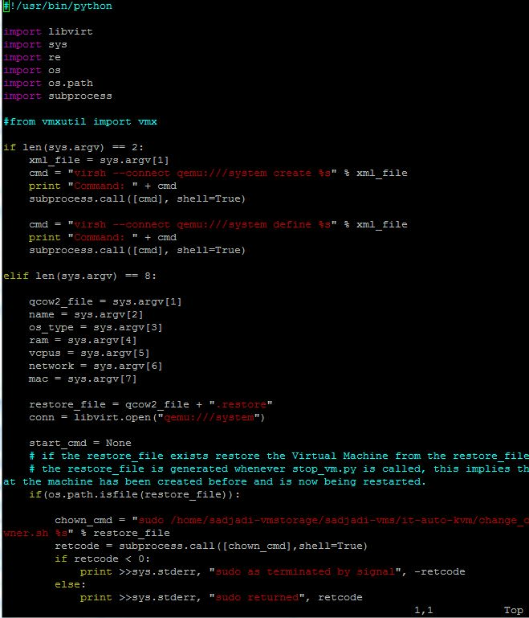
Main Algorithm
Check inputs
If inputs are equal to two create VM from input file
If inputs are equal to eight do the following
Check if restore file exists
If restore file exists restore the VM
Otherwise install the VM
If the VM is already installed but shut down Start the VM

Slide 14
Test Case (Sunny Day)
Test Case: SLSD-001
Purpose
  To see if vLabs will start with the expected inputs
Test Setup
  As administrator log-in to VC7
Test inputs
  “start_ve.py icard005test K2_6 50501 5 112233 6 1 7 0”
Expected Output
  A virtual environment for icard005test will begin
Actual Output
  Same as expected output

Slide 15
Test Case (Rainy Day)
Test Case: SLRD-005
Purpose
  To see if vLabs will start with the expected inputs when virtual machines have been manually stopped
Test Setup
  As administrator log-in to VC7 manually stop the vms
Test inputs
  “start_ve.py icard005test K2_6 50501 5 112233 6 1 7 0”
Expected Output
  A virtual environment for icard005test will begin
Actual Output
  The virtual machines would not begin

Slide 16
Questions?
Thank you

